Slide 1
Chapter 7 Techniques of Integration
Introduction

Slide 2
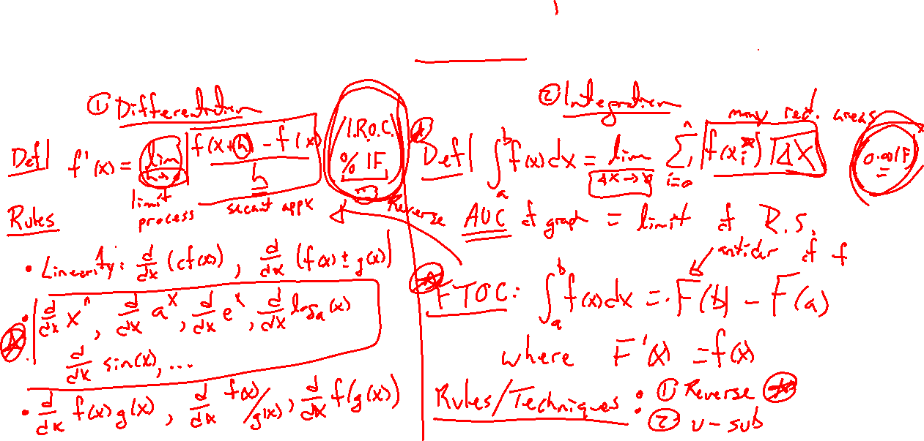
2 Main Problems of Calculus: Try on Own
Notes:
Let them explain first
Differentiation (tangent line or rates of change, easy)
Integration (area or continuous summation, hard)
Underlying math problem: study of indeterminant form

Slide 3
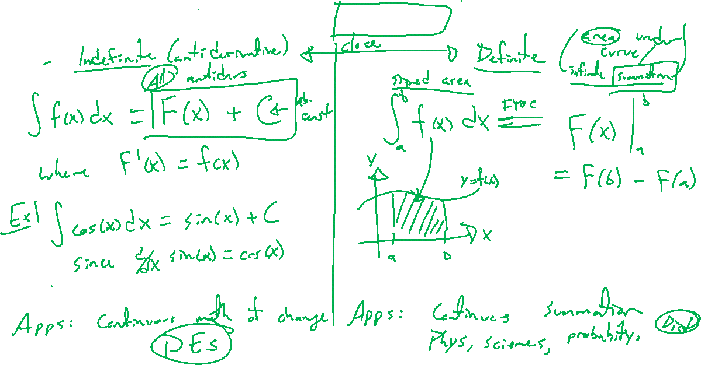
Indefinite vs Definite Integral
Notes:
Examples
Indefinite integral is reverse differentiation, note the arbitrary constant finds all antiderivatives
Definite integral is area under curve (or continuous summation)
FTOC connects and makes both reverse differentitation

Slide 4
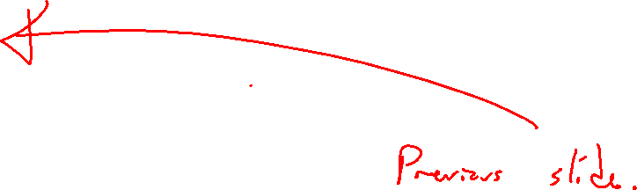
Applications of Integration
Notes:
2 groups:
Indefinite and differential equations (Chapter 9, laws (equations) to describe phenomenon involving change, physics, bio, econ, etc)
Definite and summation of continuous summation (Chapter 8, add up infinitely many quantities, probabilities, )

Slide 5
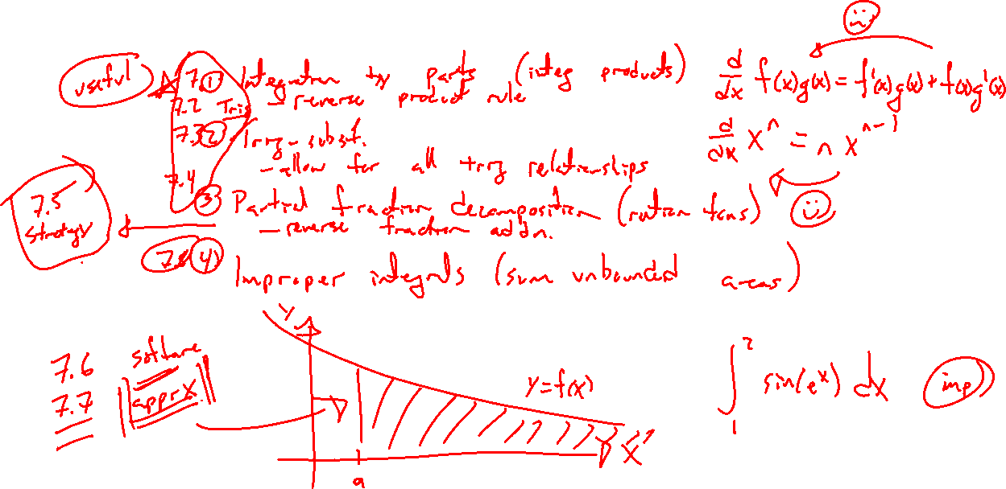
Calculus I Integration Techniques
Notes:
Direct formulas: Reverse diff rules, sum/diff/const
Reverse chain rule
What remains? Reverse product rule, leverage trig functions, partial fraction decomposition for rational functions

Slide 6
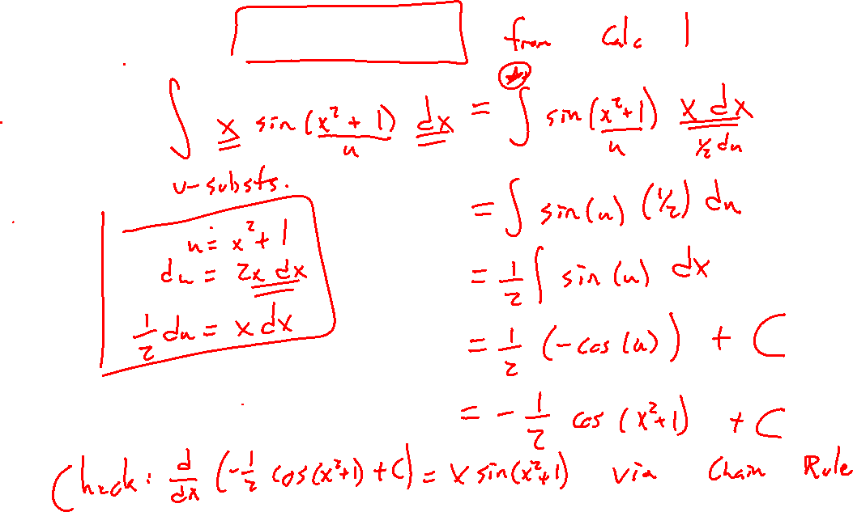
Example: Try on Own
Notes:
Substitution
\int xsin(x^2+1)~dx
Check and show is really the chain rule

Slide 7
Outline of Chapter
Notes:
Integration by parts
Trig integrals
Trig sub
PDF
Strategy for integration
Improper integrals
Note: Most of the time integration is not possible and approximation techniques are needed

